Slide 1

Programming in 4GL (DIT 100)
Unit 2.0: Database Essentials
Presented by Jacob Chikwanda

Slide 2

Goal of this unit
The goal of this chapter is to explain what a database is, describe its key features, and help you understand why businesses use data to increase profits before diving into the technical details of SQL.

Slide 3
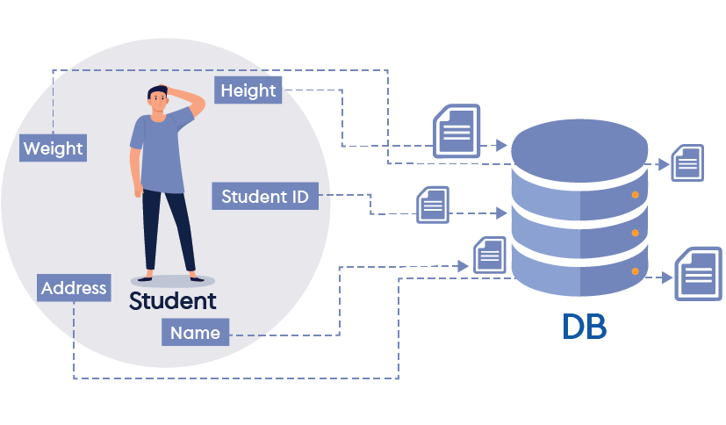
What is a database?
A tool capable of storing data and aiding in retrieving it more efficiently.
4 Important Words to Remember When We Think About A Database
Record
Attribute
Metadata
Relationship

Slide 4
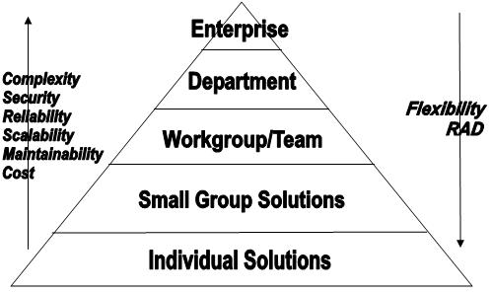
What are the 3 Categories of Databases?
Personal Database
Workspace/Departmental Database
Enterprise Database

Slide 5
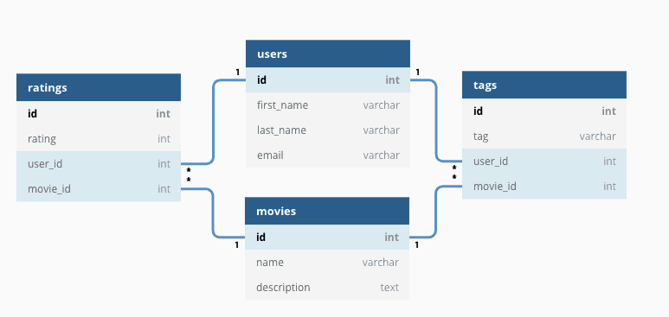
Relational Database - Getting More Technical
A relational database is a specific type of database that organizes data in tables (a.k.a relations), where each table has a row (records) and columns (fields or attributes).

Slide 6
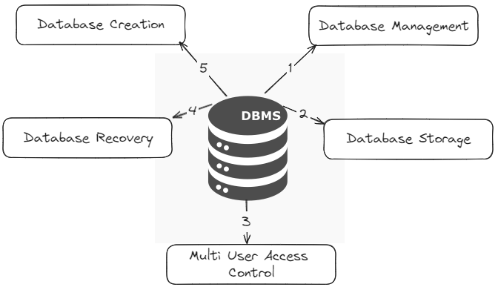
Key features of DBMS

Slide 7
Good Day!

